Slide 1
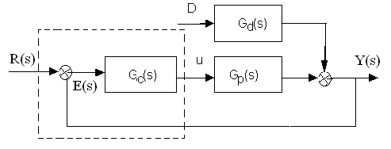
PID Controller Forms
Ideal form
K_{P}: proportional gain,
: integral time constant,
: derivative time constant
K_{I}: Integral gain,
K_{D}: Derivative gain,

Slide 2
Design -- Step 1: Factoring the model
Factor the model
contains all Nonminimum Phase Elements, RHP zeros and time delays.
The factor
is stable and causal.
Initial IMC controller defined as
The factorization of
dependent upon the objective function
Example
Integral-Absolute-Error (IAE)-optimal for step setpoint/disturbance changes.
is Integral-Square-Error (ISE)-optimal for step set point/output disturbance changes.

Slide 3
Design –Step 2: Making Controller Proper
Augment q with a filter f(s) such that the final IMC controller proper
A common filter choice that conforms to this requirement

Slide 4
Design –Step 3: Convert to Normal Form
Converted to the conventional form for implementation

Slide 5
PI Control for the First Order Model
τ > 0
under the condition that d and r are step input changes.
Step 1: Factor and invert
Step 2: Augment with a first-order filter
Step 3: solve for the classical feedback controller equivalent c(s) to obtain

Slide 6
Deadtime Control
step setpoint/output disturbance changes to the closed-loop system.
Step 1: The optimal factorization (IAE, ISE, or otherwise)
Step 2: A first-order filter makes q semiproper;
Step 3: The corresponding feedback controller is

Slide 7
PID Tuning for FOPTD Plants
Taylor approximation
A PI controller with

Slide 8
PID Tuning for FOPTD Plants
Padè-approximation
a second-order plant with RHP zero: PID tuning rule:
is a measure related to robustness of the closed-loop system.
IMC-PID controller results in an ISE value 10% more than optimal.

Slide 9
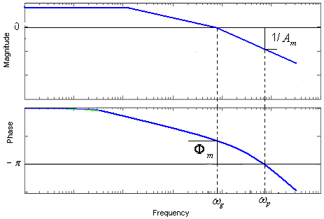
Gain and Phase Crossover Frequency
.
gain margin at phase crossover frequency
phase margins at the gain crossover frequency

Slide 10
Simplified Design-Problem Formulation
Model
PID controller
Selecting
Open loop transfer function becomes

Slide 11
Gain and Phase-Solution From
 | 2 | 3 | 4 | 5

Slide 12
Summary
Proportional: makes control proportional to error signal by all pass gain factor.
Integral: reduces steady-state errors through low-frequency compensation.
Derivative: improves transient response through high-frequency compensation.
 | Rise Time | Overshoot | Settling Time | Steady-State Error | Stability
Increasing K_{P} | Decrease | Increase | Small Increase | Decrease | Degrade
Increasing K_{I} | Small Decrease | Increase | Increase | Large Decrease | Degrade
Increasing K_{D} | Small Decrease | Decrease | Decrease | Minor Change | uncertain

